Slide 1
Multi level network training

Slide 2
Motivation
We investigate a particular training scenario where the input comes in a hierarchical way, i.e., each new hierarchical component when added to the previous components of data provide better resolution. With multiple resolution data the idea is to train a small network with lower resolution and use the trained weight to help the medium/large size network to train faster. Since small network training is relatively fast and inexpensive, the idea is doing so can help achieve faster training time overall.

Slide 3
Data generation
Here we demonstrate a 2 level approach. This can be easily applied for 3 level too.
We use the widely available MNIST dataset, the original data is 28 x 28 resolution, We downsampled it to 14 x 14 to create a lower resolution data.
The Idea is we train on the lower resolution which takes 14 x 14 image, then load the network weight into a network can take 14 x 14 + 28 x 28 input. Here the 28 x 28 input does not necessary to be the original image, in this experiment we used difference image, i.e the difference between the original 28 x 28 image and the artificial upsampled from 14x14.

Slide 4
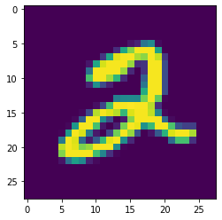
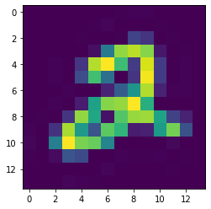

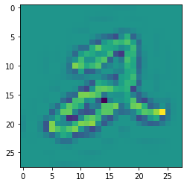
Original image
Downsampled image
Upsampled from downsampled image
Difference image

Slide 5
Example network architecture
Small: Layer 1: (64,32)
Layer 2: (32,32)
Layer 3: (32,16)
Layer 4: (16,16)
Layer 5: (16,10)
Medium: Layer 1: (320,160)
Layer 2: (160,64)
Layer 3: (64,32)
Layer 4: (32,16)
Layer 5: (16,10)

Slide 6
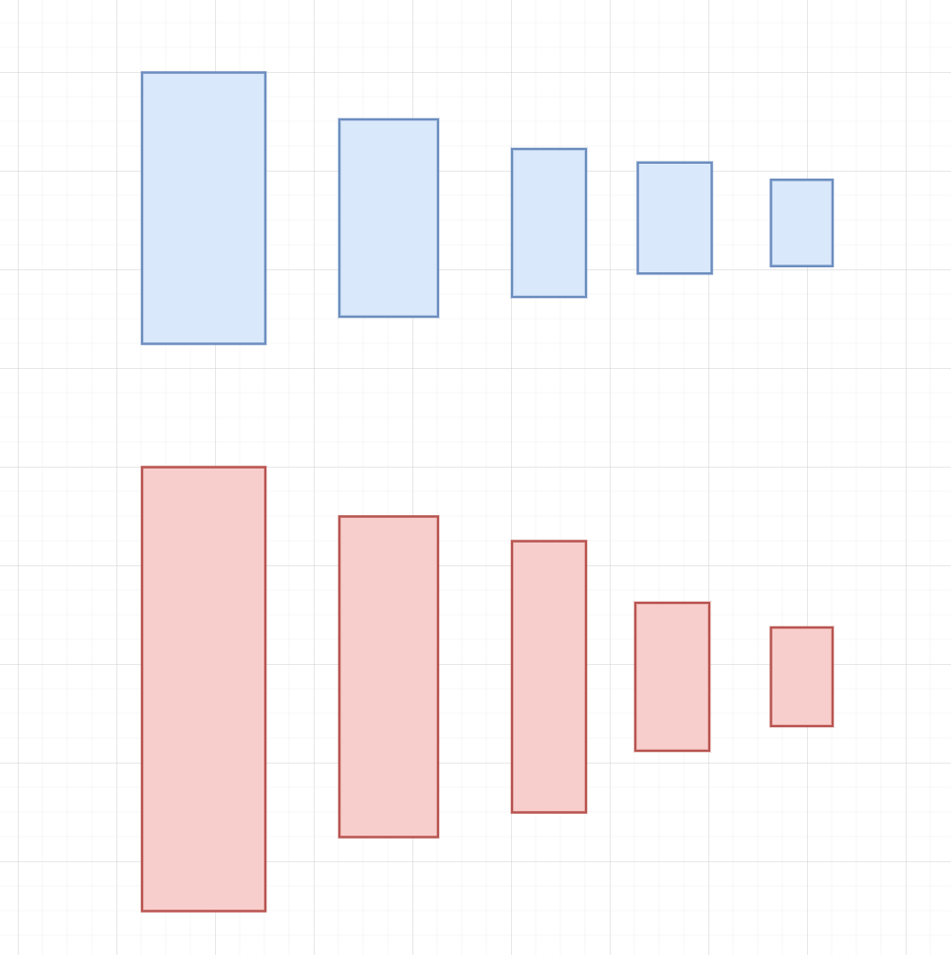
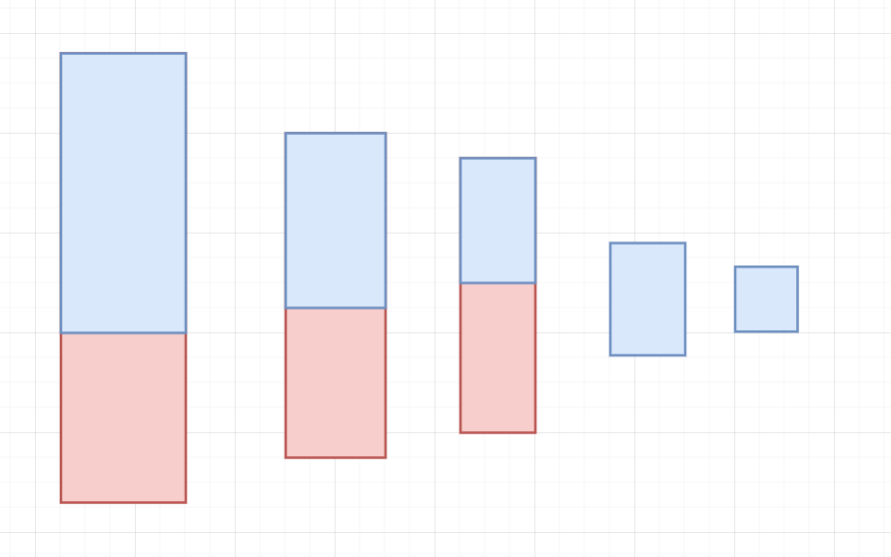
Here we have two network, the blue represent the smaller network, and red represent the larger network. The idea is we can train the blue network first, then load the blue network’s weight into the red network. For classification problem like MNIST, it is crucial the last layer size must match between the small network and the larger network.

Slide 7
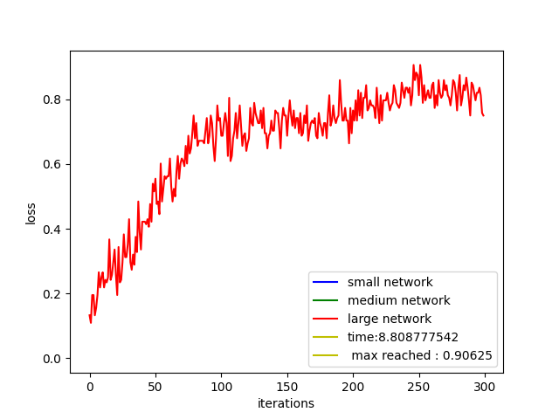
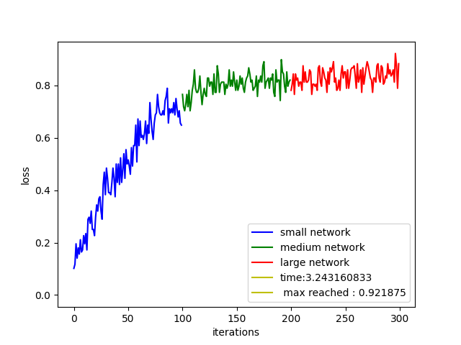
Experiment result
Here on the left, we run the large network for 300 epochs it took 8 seconds to finish and reached an accuracy 90%, on the right we trained the small, medium, large network each for 100 epochs and using load weight function, the accuracy reached 92 % and the run only took 3.2 second.
Do note the experiment is not trying to achieve the best MNIST accuracy,it is not the focus for this experiment. it is merely use the dataset as an experiment for this type of training design.

Slide 8
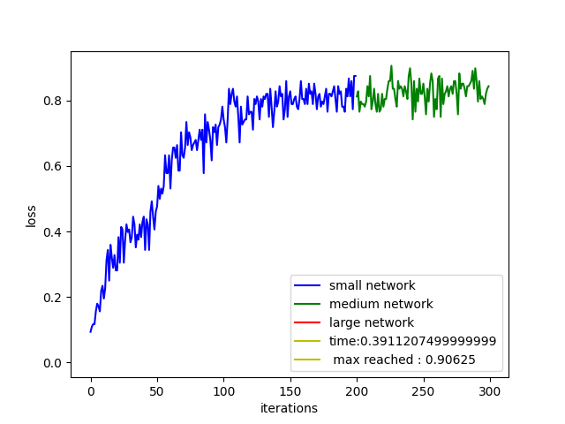
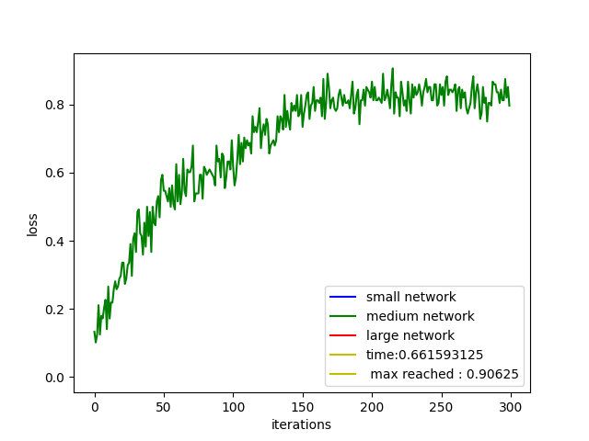
Here for two level experiment, we can see similar result, which the medium size network on it’s own runs for 300 epoch took 0.66 second and have the accuracy of 90%, where we can combine both small and medium network each with 200 epoch and 100 epoch training, it reduced the training time to 0.39 second and also reach around the same accuracy.

Slide 9
Result Analysis
The intuition behind this method is generally small network can generalize the problem a lot faster, since lower resolution input generally have less noise, the accuracy increase the most in the beginning of the training as shown in the result history, so using a small network we can quickly gain training accuracy, but since small network can quickly saturate due to it’s network size, we can use the already trained weight and use a larger network to continue improve the accuracy.
For this experiment for the simplicity I did not use any bias layer, but the idea would follow the same with loading trained bias layer into a larger one.

